Slide 1
Introduction to Programming with Python
Marty Stepp (stepp@cs.washington.edu)
Lecturer, Computer Science & Engineering
University of Washington

Slide 2
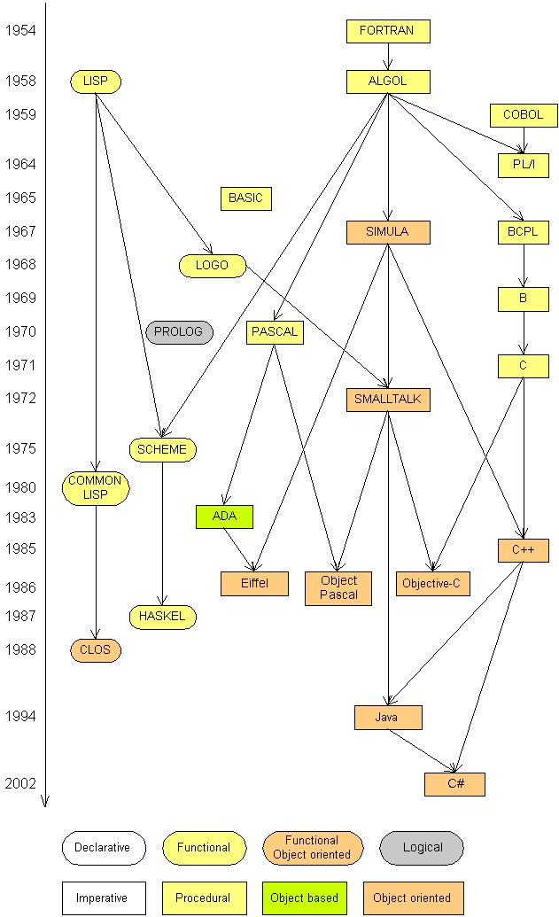
Languages
Some influential ones:
FORTRAN
science / engineering
COBOL
business data
LISP
logic and AI
BASIC
a simple language

Slide 3
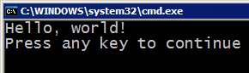
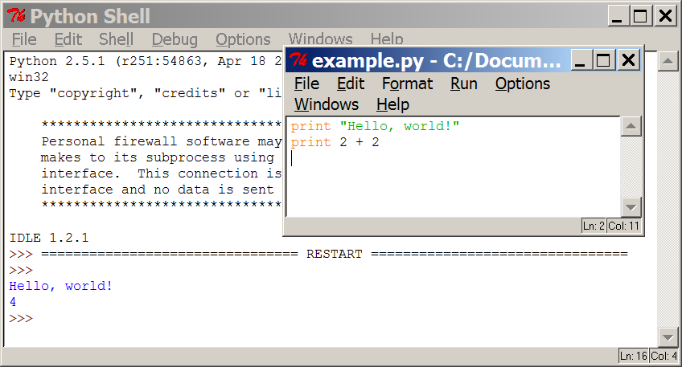
Programming basics
code or source code: The sequence of instructions in a program.
syntax: The set of legal structures and commands that can be used in a particular programming language.
output: The messages printed to the user by a program.
console: The text box onto which output is printed.
Some source code editors pop up the console as an external window, and others contain their own console window.

Slide 4




Compiling and interpreting
Many languages require you to compile (translate) your program into a form that the machine understands.
Python is instead directly interpreted into machine instructions.
compile
execute
source code
Hello.java
byte code
Hello.class
output
interpret
source code
Hello.py
output

Slide 5
Expressions
expression: A data value or set of operations to compute a value.
Examples: 1 + 4 * 3
42
Arithmetic operators we will use:
+ - * / addition, subtraction/negation, multiplication, division
% modulus, a.k.a. remainder
** exponentiation
precedence: Order in which operations are computed.
* / % ** have a higher precedence than + - 1 + 3 * 4 is 13
Parentheses can be used to force a certain order of evaluation. (1 + 3) * 4 is 16

Slide 6
Integer division
When we divide integers with / , the quotient is also an integer.
3 52
4 ) 14 27 ) 1425
12 135
2 75
54
21
More examples:
35 / 5 is 7
84 / 10 is 8
156 / 100 is 1
The % operator computes the remainder from a division of integers.
3 43
4 ) 14 5 ) 218
12 20
2 18
15
3
Notes:
Dividing by 0 crashes the program.

Slide 7
Real numbers
Python can also manipulate real numbers.
Examples: 6.022 -15.9997 42.0 2.143e17
The operators + - * / % ** ( ) all work for real numbers.
The / produces an exact answer: 15.0 / 2.0 is 7.5
The same rules of precedence also apply to real numbers: Evaluate ( ) before * / % before + -
When integers and reals are mixed, the result is a real number.
Example: 1 / 2.0 is 0.5
The conversion occurs on a per-operator basis.
7 / 3 * 1.2 + 3 / 2
2 * 1.2 + 3 / 2
2.4 + 3 / 2
2.4 + 1
3.4

Slide 8
Math commands
Python has useful commands for performing calculations.
To use many of these commands, you must write the following at the top of your Python program:
from math import *
Command name | Description
abs(value) | absolute value
ceil(value) | rounds up
cos(value) | cosine, in radians
floor(value) | rounds down
log(value) | logarithm, base e
log10(value) | logarithm, base 10
max(value1, value2) | larger of two values
min(value1, value2) | smaller of two values
round(value) | nearest whole number
sin(value) | sine, in radians
sqrt(value) | square root
Constant | Description
e | 2.7182818...
pi | 3.1415926...

Slide 9
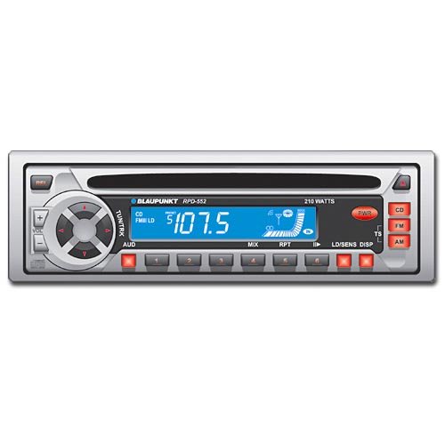
Variables
variable: A named piece of memory that can store a value.
Usage:
Compute an expression's result,
store that result into a variable,
and use that variable later in the program.
assignment statement: Stores a value into a variable.
Syntax:
name = value
Examples: x = 5
gpa = 3.14
x 5 gpa 3.14
A variable that has been given a value can be used in expressions.
x + 4 is 9
Exercise: Evaluate the quadratic equation for a given a, b, and c.

Slide 10
print
print : Produces text output on the console.
Syntax:
print "Message"
print Expression
Prints the given text message or expression value on the console, and moves the cursor down to the next line.
print Item1, Item2, ..., ItemN
Prints several messages and/or expressions on the same line.
Examples:
print "Hello, world!"
age = 45
print "You have", 65 - age, "years until retirement"
Output:
Hello, world!
You have 20 years until retirement

Slide 11
input
input : Reads a number from user input.
You can assign (store) the result of input into a variable.
Example:
age = input("How old are you? ")
print "Your age is", age
print "You have", 65 - age, "years until retirement"
Output:
How old are you? 53
Your age is 53
You have 12 years until retirement
Exercise: Write a Python program that prompts the user for his/her amount of money, then reports how many Nintendo Wiis the person can afford, and how much more money he/she will need to afford an additional Wii.

Slide 12
Repetition (loops) and Selection (if/else)

Slide 13
The for loop
for loop: Repeats a set of statements over a group of values.
Syntax:
for variableName in groupOfValues:
statements
We indent the statements to be repeated with tabs or spaces.
variableName gives a name to each value, so you can refer to it in the statements.
groupOfValues can be a range of integers, specified with the range function.
Example:
for x in range(1, 6):
print x, "squared is", x * x
Output:
1 squared is 1
2 squared is 4
3 squared is 9
4 squared is 16
5 squared is 25

Slide 14
range
The range function specifies a range of integers:
range(start, stop) - the integers between start (inclusive)
and stop (exclusive)
It can also accept a third value specifying the change between values.
range(start, stop, step) - the integers between start (inclusive)
and stop (exclusive) by step
Example:
for x in range(5, 0, -1):
print x
print "Blastoff!"
Output:
5
4
3
2
1
Blastoff!
Exercise: How would we print the "99 Bottles of Beer" song?

Slide 15
Cumulative loops
Some loops incrementally compute a value that is initialized outside the loop. This is sometimes called a cumulative sum.
sum = 0
for i in range(1, 11):
sum = sum + (i * i)
print "sum of first 10 squares is", sum
Output:
sum of first 10 squares is 385
Exercise: Write a Python program that computes the factorial of an integer.

Slide 16
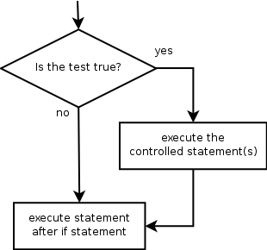
if
if statement: Executes a group of statements only if a certain condition is true. Otherwise, the statements are skipped.
Syntax:
if condition:
statements
Example:
gpa = 3.4
if gpa > 2.0:
print "Your application is accepted."

Slide 17
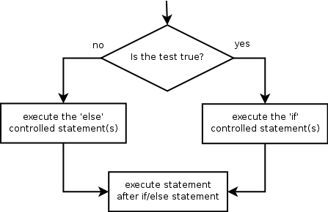
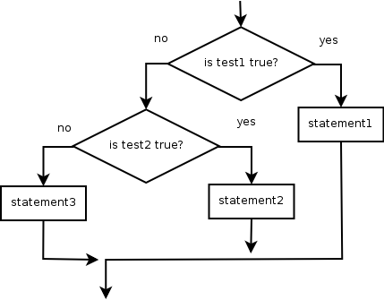
if/else
if/else statement: Executes one block of statements if a certain condition is True, and a second block of statements if it is False.
Syntax:
if condition:
statements
else:
statements
Example:
gpa = 1.4
if gpa > 2.0:
print "Welcome to Mars University!"
else:
print "Your application is denied."
Multiple conditions can be chained with elif ("else if"):
if condition:
statements
elif condition:
statements
else:
statements

Slide 18
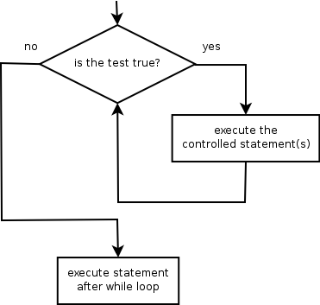
while
while loop: Executes a group of statements as long as a condition is True.
good for indefinite loops (repeat an unknown number of times)
Syntax:
while condition:
statements
Example:
number = 1
while number < 200:
print number,
number = number * 2
Output:
1 2 4 8 16 32 64 128

Slide 19
Logic
Many logical expressions use relational operators:
Logical expressions can be combined with logical operators:
Exercise: Write code to display and count the factors of a number.
Operator | Meaning | Example | Result
== | equals | 1 + 1 == 2 | True
!= | does not equal | 3.2 != 2.5 | True
< | less than | 10 < 5 | False
> | greater than | 10 > 5 | True
<= | less than or equal to | 126 <= 100 | False
>= | greater than or equal to | 5.0 >= 5.0 | True
Operator | Example | Result
and | 9 != 6 and 2 < 3 | True
or | 2 == 3 or -1 < 5 | True
not | not 7 > 0 | False

Slide 20
Text and File Processing

Slide 21
Strings
string: A sequence of text characters in a program.
Strings start and end with quotation mark " or apostrophe ' characters.
Examples: "hello" "This is a string" "This, too, is a string. It can be very long!"
A string may not span across multiple lines or contain a " character. "This is not a legal String."
"This is not a "legal" String either."
A string can represent characters by preceding them with a backslash.
\t tab character
\n new line character
\" quotation mark character
\\ backslash character
Example: "Hello\tthere\nHow are you?"

Slide 22
Indexes
Characters in a string are numbered with indexes starting at 0:
Example:
name = "P. Diddy"
Accessing an individual character of a string:
variableName [ index ]
Example:
print name, "starts with", name[0]
Output:
P. Diddy starts with P
index | 0 | 1 | 2 | 3 | 4 | 5 | 6 | 7
character | P | . |  | D | i | d | d | y

Slide 23
String properties
len(string) - number of characters in a string
(including spaces)
str.lower(string) - lowercase version of a string
str.upper(string) - uppercase version of a string
Example:
name = "Martin Douglas Stepp"
length = len(name)
big_name = str.upper(name)
print big_name, "has", length, "characters"
Output:
MARTIN DOUGLAS STEPP has 20 characters

Slide 24
raw_input
raw_input : Reads a string of text from user input.
Example:
name = raw_input("Howdy, pardner. What's yer name? ")
print name, "... what a silly name!"
Output:
Howdy, pardner. What's yer name? Paris Hilton
Paris Hilton ... what a silly name!

Slide 25
Text processing
text processing: Examining, editing, formatting text.
often uses loops that examine the characters of a string one by one
A for loop can examine each character in a string in sequence.
Example:
for c in "booyah":
print c
Output:
b
o
o
y
a
h

Slide 26
Strings and numbers
ord(text) - converts a string into a number.
Example: ord("a") is 97, ord("b") is 98, ...
Characters map to numbers using standardized mappings such as ASCII and Unicode.
chr(number) - converts a number into a string.
Example: chr(99) is "c"
Exercise: Write a program that performs a rotation cypher.
e.g. "Attack" when rotated by 1 becomes "buubdl"

Slide 27
File processing
Many programs handle data, which often comes from files.
Reading the entire contents of a file:
variableName = open("filename").read()
Example:
file_text = open("bankaccount.txt").read()

Slide 28
Line-by-line processing
Reading a file line-by-line:
for line in open("filename").readlines():
statements
Example:
count = 0
for line in open("bankaccount.txt").readlines():
count = count + 1
print "The file contains", count, "lines."
Exercise: Write a program to process a file of DNA text, such as:
ATGCAATTGCTCGATTAG
Count the percent of C+G present in the DNA.

Slide 29
Graphics

Slide 30
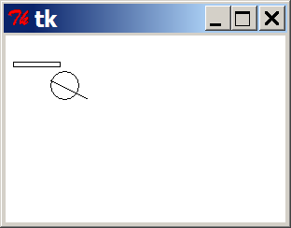
DrawingPanel
To create a window, create a drawingpanel and its graphical pen, which we'll call g :
from drawingpanel import *
panel = drawingpanel(width, height)
g = panel.get_graphics()
... (draw shapes here) ...
panel.mainloop()
The window has nothing on it, but we can draw shapes and lines on it by sending commands to g .
Example:
g.create_rectangle(10, 30, 60, 35)
g.create_oval(80, 40, 50, 70)
g.create_line(50, 50, 90, 70)

Slide 31
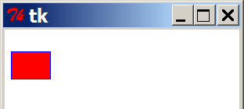
Graphical commands
Command | Description
g.create_line(x1, y1, x2, y2) | a line between (x1, y1), (x2, y2)
g.create_oval(x1, y1, x2, y2) | the largest oval that fits in a box with top-left corner at (x1, y1) and bottom-left corner at (x2, y2)
g.create_rectangle(x1, y1, x2, y2) | the rectangle with top-left corner at (x1, y1), bottom-left at (x2, y2)
g.create_text(x, y, text="text") | the given text at (x, y)
The above commands can accept optional outline and fill colors.
g.create_rectangle(10, 40, 22, 65, fill="red", outline="blue")
The coordinate system is y-inverted:
(0, 0)
(200, 100)

Slide 32
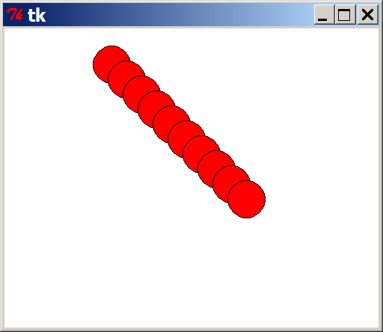
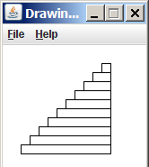
Drawing with loops
We can draw many repetitions of the same item at different x/y positions with for loops.
The x or y assignment expression contains the loop counter, i, so that in each pass of the loop, when i changes, so does x or y.
from drawingpanel import *
window = drawingpanel(500, 400)
g = window.get_graphics()
for i in range(1, 11):
x = 100 + 20 * i
y = 5 + 20 * i
g.create_oval(x, y, x + 50, y + 50, fill="red")
window.mainloop()
Exercise: Draw the figure at right.

Slide 33
What's Next?

Slide 34
Further programming
Lab exercises
Let's go downstairs to the basement computer labs!
All resources are available at the following URL:
http://faculty.washington.edu/stepp/cs4hs/
What next?
Arrays, data structures
Algorithms: searching, sorting, recursion, etc.
Objects and object-oriented programming
Graphical user interfaces, event-driven programming

